Slide 1
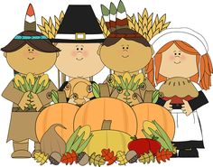
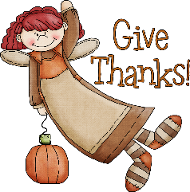
Name: ___________________________________________________
Spelling Words
Week 16 11/21-11/30
wheat
window
catch
catcher
kitchen
butcher
black
warm
unless
clothing
clothes
clothe
began
begin
beginning
able
gone
go
done
do
suit
track
watch
dash
fell
fight
fell
fight
buy
by
Reading Minutes You can log minutes online here: https://goo.gl/forms/WMfqHRTbBoEV01DK2
 | Minutes |  | Minutes
Friday |  | Tuesday
Saturday |  | Wednesday
Sunday |  | Thursday
Monday |  | Total Minutes
Vocabulary
Allowed
Powerful
Invented
Instrument
Products
Design
Bonus Words
Acquire
Ancient
Anyone
Apiece
Approaches
Phonograms
/ng/ /ch/ /ee/ /dge/ /y/ /oi/ /ey/ /e/ /ck/ /igh/ /or/

Slide 2
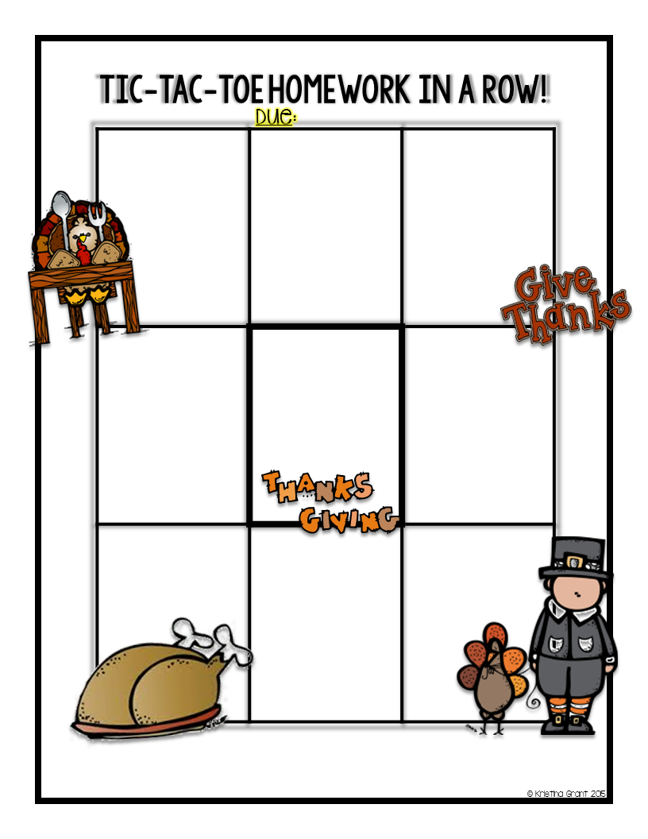
Second Grade Week 16
Thursday, November 30
Write 10 sentences about your Thanksgiving break using at least 10 spelling words.
Draw a November picture and hide 10 words inside of it.
Write a friendly letter to a Turkey. Use at least 10 spelling words.
Create your own activity to practice your spelling words.
SPELLING CITY
Do any activity with your words(parent signature required)
1 session of Imagine Learning (https://go.imaginelearning.com)
Site code: 4900137
Write 10 spelling words in ABC order.
Rainbow words
Use 10 spelling words.
Write 10 spelling words. Use black for the consonants and brown for the vowels.
Complete 3 different squares. Have an adult initial the square or turn in your work with your packet.

